Slide 1
Image Based Price Estimation Model
CSE 498: Deep Learning
Sponsor: Dr. Parv Venkitasubramaniam
Yan Huang, Vyshnavi Kondapalli, Xiang Gao, Lauri Soome

Slide 2
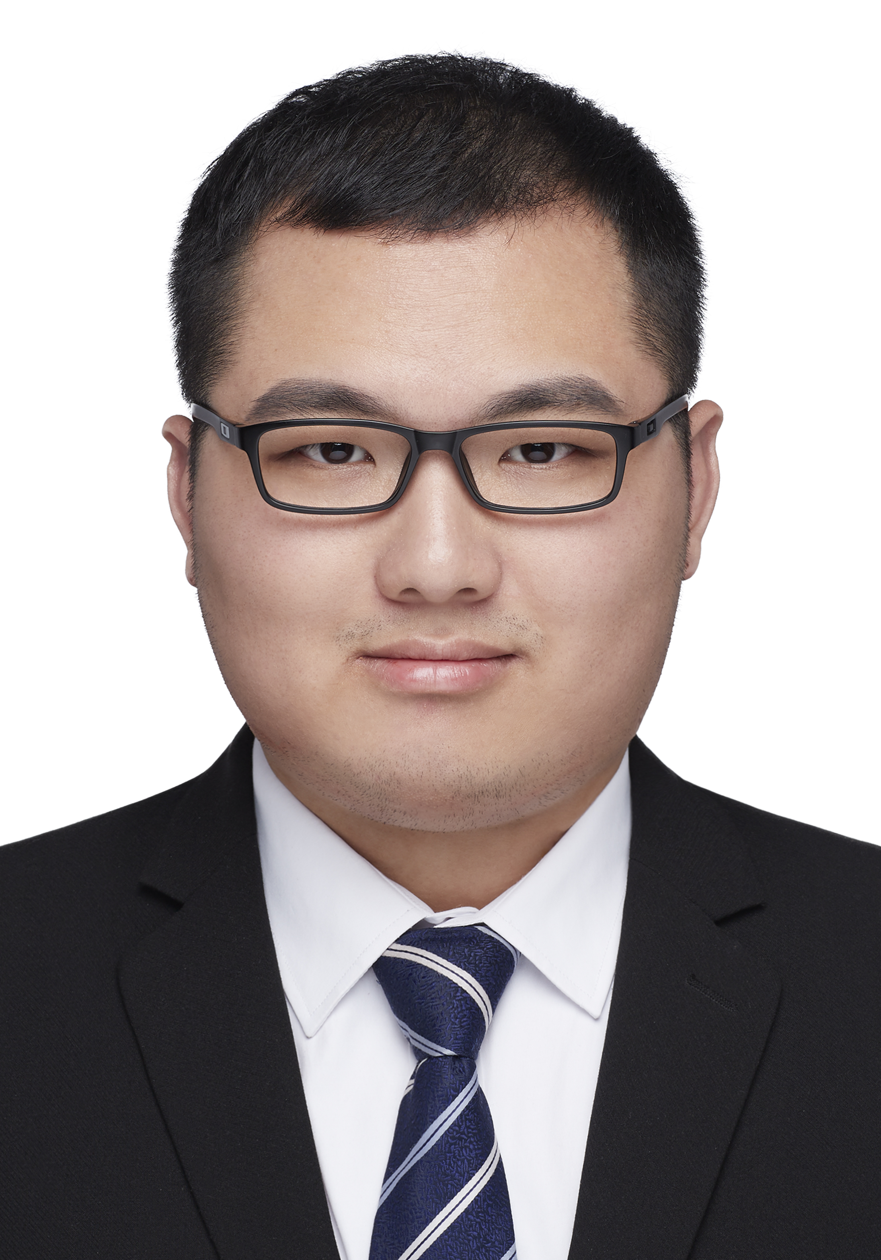



Yan H.
Meet the Team
Vyshnavi K.
Xiang G.
Lauri S.
M.S Data Science
yah423@lehigh.edu
M.S Data Science
vyk223@lehigh.edu
M.S Data Science
xig423@lehigh.edu
M.S Data Science
las623@lehigh.edu

Slide 3
Time Plan
Week 4 – Proposal Presentation
Week 4 – Week 6 Methodology Research & Data Collection
Week 7 – Week 8 Data Processing & Benchmark Baseline Model
Week 8 – Midterm Presentation
Week 9 – Week 11 Model Selection & Improvement
Week 12 – Week 14 Inference, Analysis & Reporting
Week 15 – Final Presentation

Slide 4
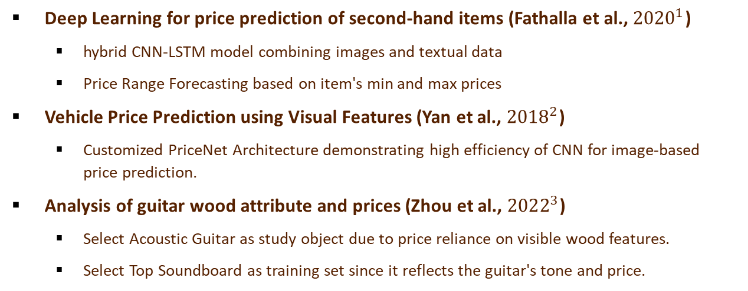
Methodology Research
Deep Learning for price prediction of second-hand items (Fathalla et al., ${2020}^{1}$)
hybrid CNN-LSTM model combining images and textual data
Price Range Forecasting based on item's min and max prices
Vehicle Price Prediction using Visual Features (Yan et al., ${2018}^{2}$)
Customized PriceNet Architecture demonstrating high efficiency of CNN for image-based price prediction.
Analysis of guitar wood attribute and prices (Zhou et al., ${2022}^{3}$)
Select Acoustic Guitar as study object due to price reliance on visible wood features.
Select Top Soundboard as training set since it reflects the guitar's tone and price.

Slide 5
Data Collection
Gather datasets containing second-hand guitar images and corresponding price data
Choose the Guitar Center website as the data source
The Guitar Center offers 4000+ guitar images by featuring reasonably priced items rather than luxury options.
Gather second-hand guitar images from sources
Automatically download the mhtml files of Guitar Center web pages to the local.
Retrieve the links of guitar images from local web pages.
Download 4000+ second-hand guitar images using the links.

Slide 6
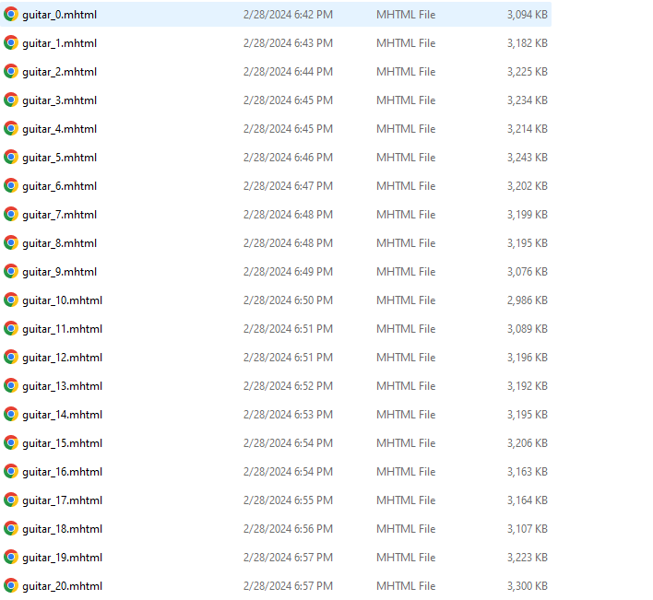
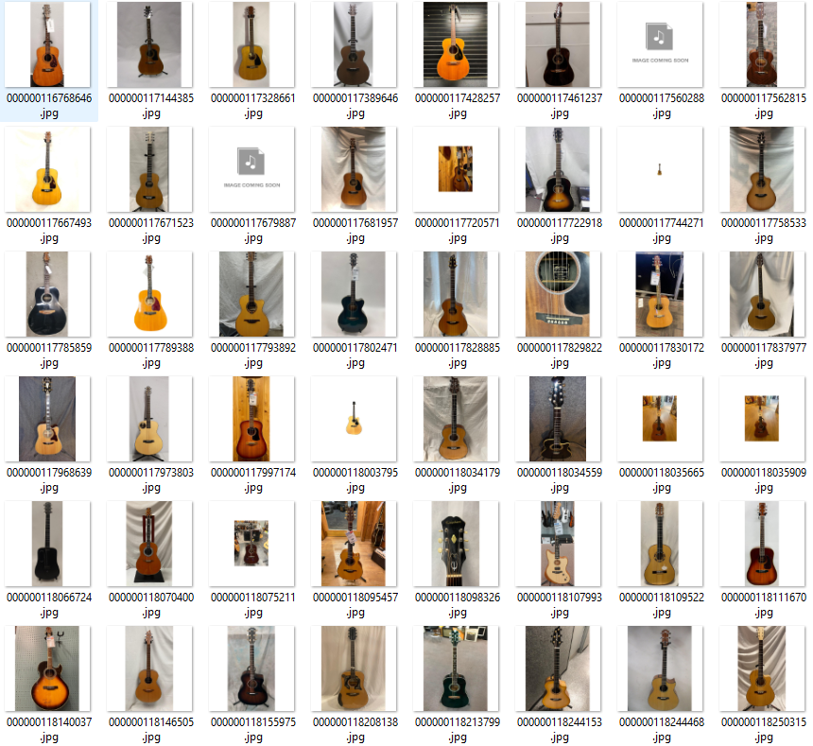
Data Collection

Slide 7
Data Processing
Automatically remove the background of guitar images
Manually eliminate invalid images
Remove electric guitar images, dummy images, unclear images, etc.
Crop the images to keep the top soundboard of guitars exclusively
Design an algorithm for batch cropping guitar images based on guitar’s shape and proportions.
Resize and pad the guitar images
Downsample all images to 200 pixels in height, then add white padding to reach a uniform width of 200 pixels.

Slide 8
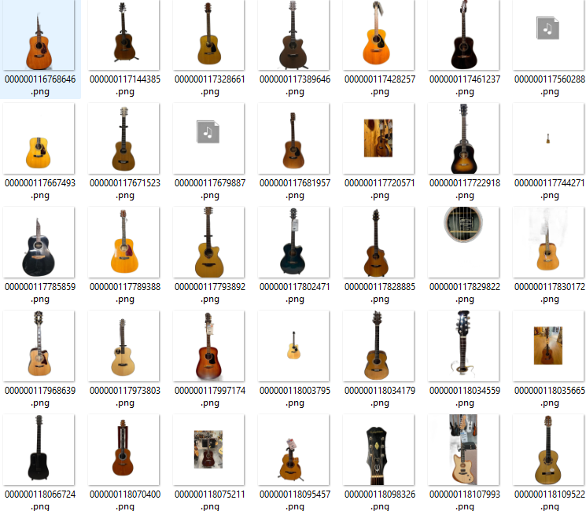
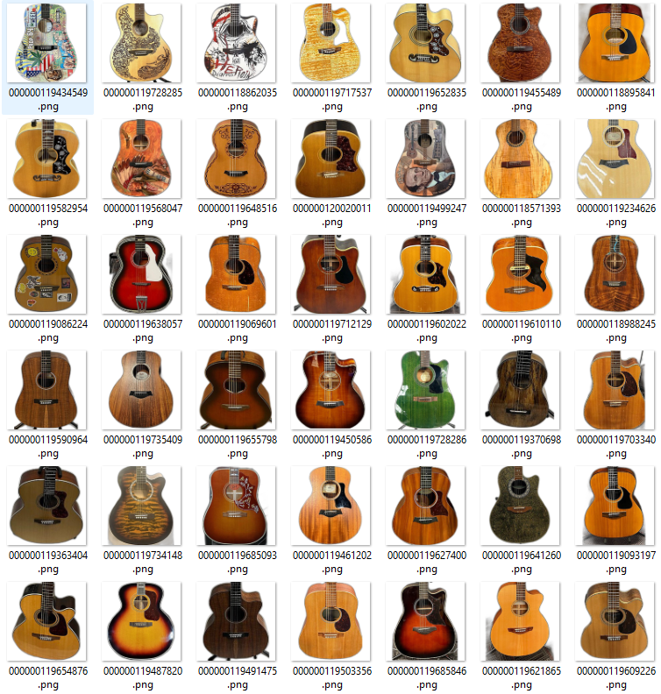
Data Processing

Slide 9
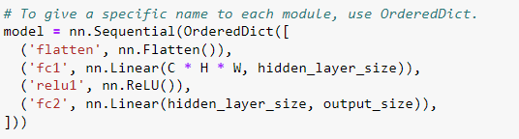
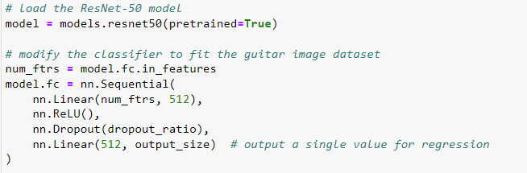
Benchmark Baseline Model
Two-layer fully connected neural network
Act as a toy model to verify preprocessing steps and dataset splits.
ResNet-50
Set a performance threshold for future improvements.

Slide 10
Thank you

